Slide 1
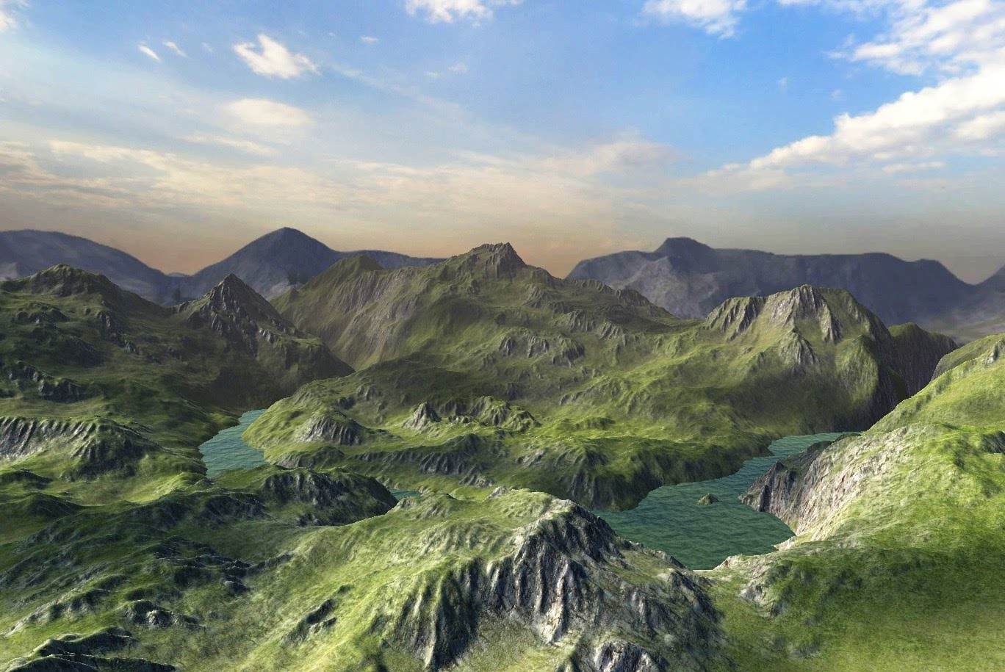
CO405 Level Design

Slide 2

We will use the Unity Game Engine as a vehicle to experiment with audio & visual effects in game environments!
Unity is a rendering engine with integrated tools
Supports 2D & 3D
Multi platform support
Supports team development
Built in support for Rendering, Physics, Lighting, Terrains, Special Effects, Materials and AI
Mecanim & keyframe animation support
VR / AR / XR

Slide 3
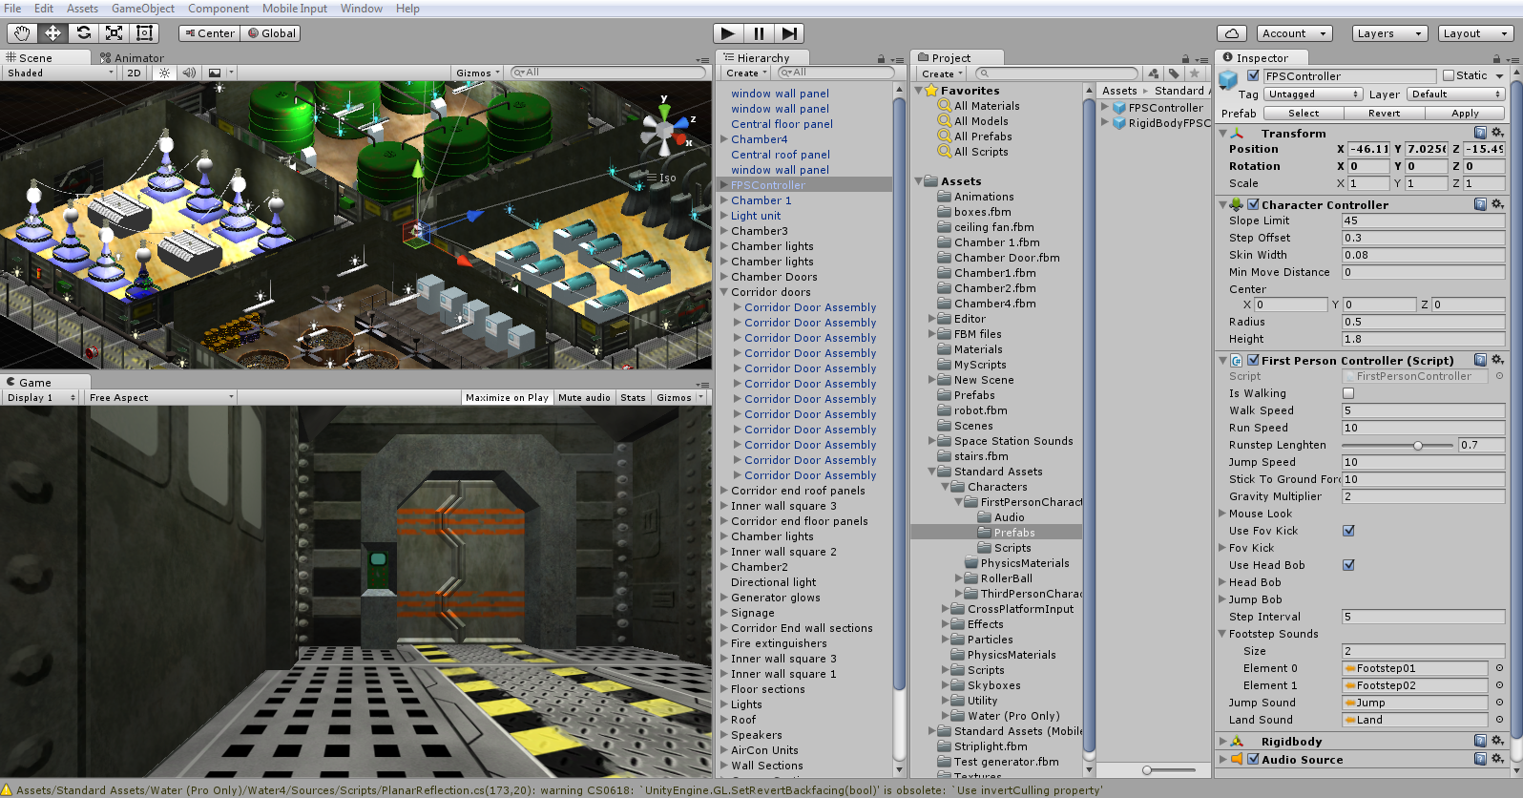
Edit window
Game preview
Unity Project Folder

Slide 4
Hierarchy
Panel
Contains all
components
used in the scene
Unity Project Folder

Slide 5
Project
Panel
contains everything
in the project organized
into folders… items can be dragged into these from Windows or Imported
Unity Project Folder

Slide 6
Inspector
Panel
properties of any selected object
Can add
COMPONENTS from here to objects
Unity Project Folder

Slide 7
A Unity Project: contains Scenes (‘levels’) Scenes are comprised of GameObjects
models, lights, geometry GameObjects all contain Components
scripts, effects, physics controllers colliders, animations, materials
all have a Transform Component

Slide 8
Assets models & materials can be imported or some even made in Unity including 3D objects, particle systems, terrain and prefabs
Prefabs are made of various components saved as grouped elements which can be instanced into the scene

Slide 9
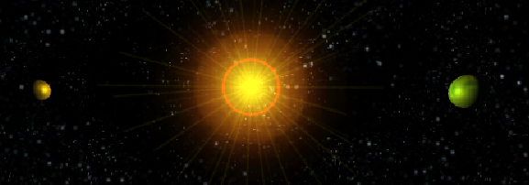
As an introduction, today you will build a Solar System model in Unity this will involve making assets, materials and prefabs and adding components such as effects and scripted elements!

Slide 10
You can load unity for free from unity.com
BEWARE - install the version that is compatible with the University configuration (currently version 2018.x)
Unity versions are not backwards compatible
Forward compatibility is also risky – Unity will automatically try to update a project if it was created in a previous version – and it will overwrite the older version often with disastrous consequences….
The Unity Pro version requires a licence……..

Slide 11
I3-M7AD-279S-X79U-FPTT-854R

